Slide 1
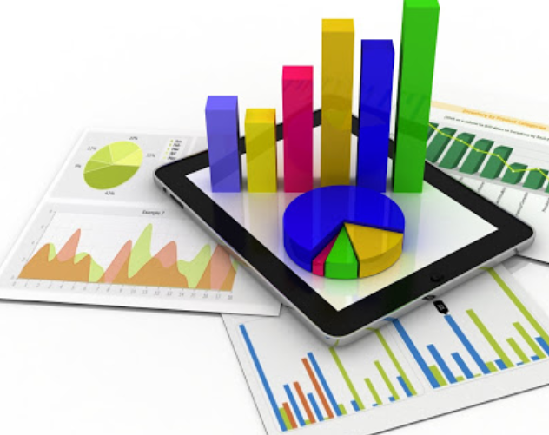
Chapter 1
Data and Statistics

Slide 2
Chapter 1 - Data and Statistics
Statistics
Applications in Business and Economics
Descriptive Statistics
Inferential Statistics
Data Classification
Data Sources
Analytics
Big Data and Data Mining
Ethical Guidelines for Statistical Practice

Slide 3
What is Statistics?
The term statistics can refer to numerical facts such as averages, medians, percentages, and maximums that help us understand a variety of business and economic situations.
Statistics can also refer to the art and science of collecting, analyzing, presenting, and interpreting data to assist in making more effective decisions.

Slide 4
Applications in Business and Economics
Accounting
Public accounting firms use statistical sampling procedures when conducting audits for their clients.
Economics
Economists use statistical information in making forecasts about the future of the economy or some aspect of it.
Finance
Financial advisors use price-earnings ratios and dividend yields to guide their investment advice.

Slide 5
Applications in Business and Economics
Marketing
Electronic point-of-sale scanners at retail checkout counters are used to collect data for a variety of marketing research applications.
Production
A variety of statistical quality control charts are used to monitor the output of a production process.
Information Systems
A variety of statistical information helps administrators assess the performance of computer networks.

Slide 6
Descriptive Statistics
Most of the statistical information in newspapers, magazines, company reports, and other publications consists of data that are summarized and presented in a form that is easy to understand.
Such summaries of data, which may be tabular, graphical, or numerical, are referred to as descriptive statistics.
Example
The manager of Hudson Auto would like to have a better understanding of the cost of parts used in the engine tune-ups performed in her shop. She examines 50 customer invoices for tune-ups. The costs of parts, rounded to the nearest dollar, are listed on the next slide.

Slide 7
Example: Hudson Auto Repair
Sample of Parts Cost ($) for 50 Tune-ups
91 | 78 | 93 | 57 | 75 | 52 | 99 | 80 | 97 | 62
71 | 69 | 72 | 89 | 66 | 75 | 79 | 75 | 72 | 76
104 | 74 | 62 | 68 | 97 | 105 | 77 | 65 | 80 | 109
85 | 97 | 88 | 68 | 83 | 68 | 71 | 69 | 67 | 74
62 | 82 | 98 | 101 | 79 | 105 | 79 | 69 | 62 | 73

Slide 8
Tabular Summary: Frequency and Percent Frequency
Parts Cost ($) | Frequency | Percent Frequency
50-59 | 2 | 4%
60-69 | 13 | 26%
70-79 | 16 | 32%
80-89 | 7 | 14%
90-99 | 7 | 14%
100-109 | 5 | 10%
TOTAL | 50 | 100%

Slide 9
Graphical Summary: Histogram
Example: Hudson Auto

Slide 10
Numerical Descriptive Statistics
The most common numerical descriptive statistic is the mean (or average).
The mean demonstrates a measure of the central tendency, or central location of the data for a variable.
Hudson’s mean cost of parts, based on the 50 tune-ups studied is $79 (found by summing up the 50 cost values and then dividing by 50).

Slide 11
Inferential Statistics
Population: The set of all elements of interest in a particular study.
Sample: A subset of the population.
Statistical inference: The process of using data obtained from a sample to make estimates and test hypotheses about the characteristics of a population.
Census: Collecting data for the entire population.
Sample survey: Collecting data for a sample.

Slide 12
Process of Statistical Inference
Step 1
Population consists of all tune ups. Average cost of parts is unknown.
Step 2
A sample of 50 engine tune-ups is examined.
Step 3
The sample data provides a sample average parts cost of $79 per tune-up.
Step 4
The sample average is used to estimate the population average.
Example: Hudson Auto

Slide 13
Population and Sample
Population
Sample
Use statistics to summarize features
Use parameters to summarize features
Inference on the population from the sample

Slide 14
Data and Data Sets
Data are the facts and figures collected, analyzed, and summarized for presentation and interpretation.
All the data collected in a particular study are referred to as the data set for the study.

Slide 15
Elements, Variables, and Observations
Elements are the entities on which data are collected.
A variable is a characteristic of interest for the elements.
The set of measurements obtained for a particular element is called an observation.
A data set with n elements contains n observations.
The total number of data values in a complete data set is the number of elements multiplied by the number of variables.

Slide 16
Data, Data Sets, Elements, Variables, and Observations
Variables
Company | Stock Exchange | Annual Sales ($M) | Earnings per share ($)
Dataram | NQ | 73.10 | 0.86
EnergySouth | N | 74.00 | 1.67
Keystone | N | 365.70 | 0.86
LandCare | NQ | 111.40 | 0.33
Psychemedics | N | 17.60 | 0.13
Observation
Element Names
Data Set

Slide 17
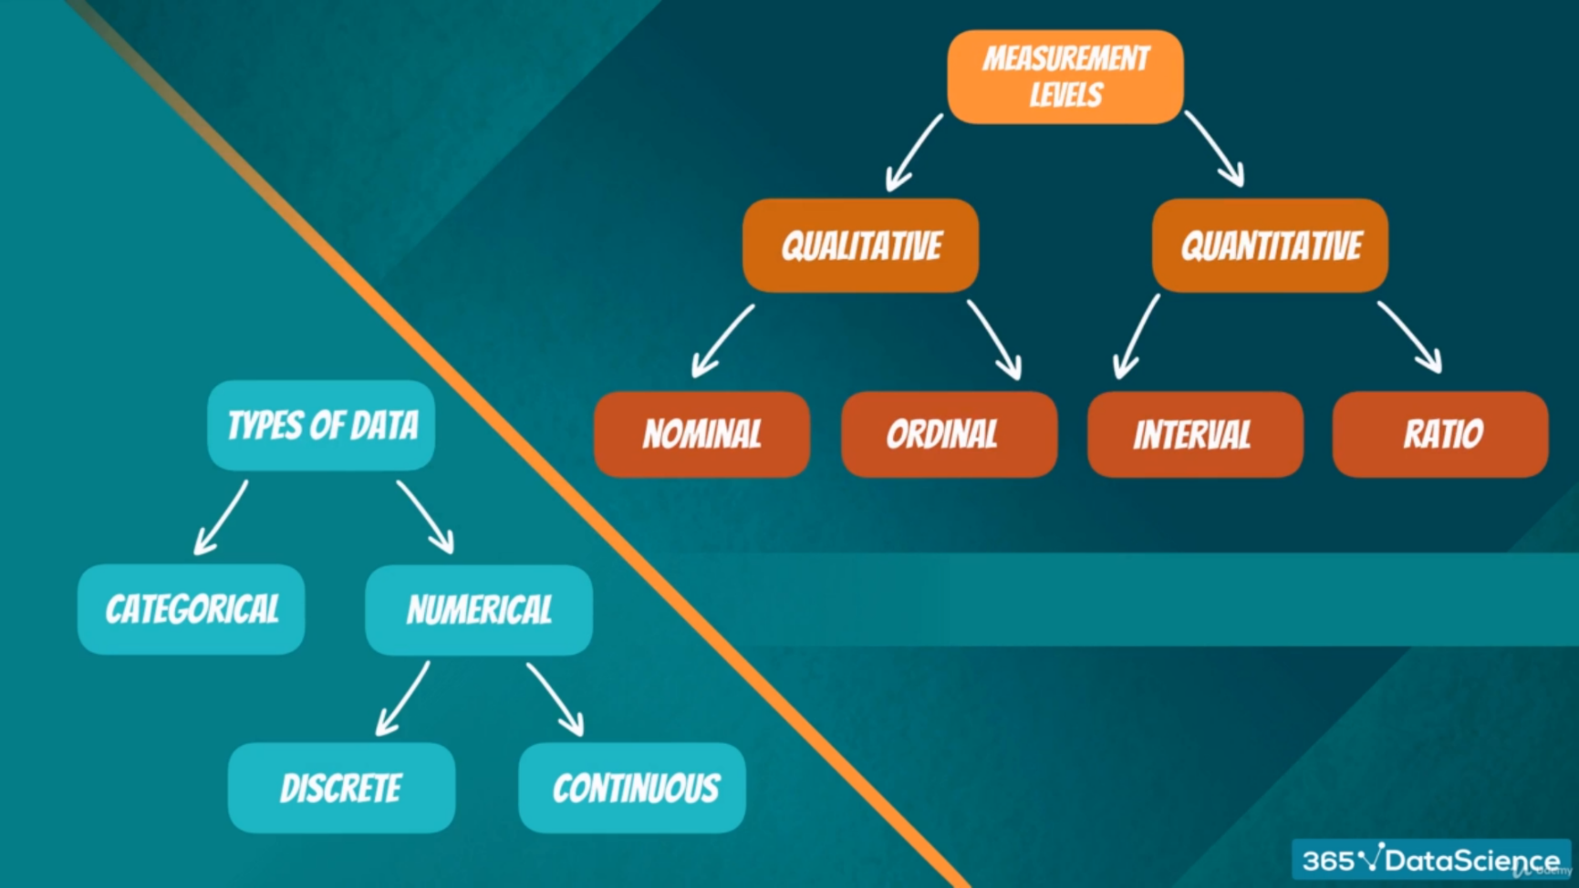
Data Categorization

Slide 18
Categorical/Qualitative and Quantitative Data
Data can be further classified as being categorical or quantitative.
The statistical analysis that is appropriate depends on whether the data for the variable are categorical or quantitative.
In general, there are more alternatives for statistical analysis when the data are quantitative.

Slide 19
Categorical Data
Labels or names are used to identify an attribute of each element
Often referred to as qualitative data
Use either the nominal or ordinal scale of measurement
Can be either numeric or nonnumeric
Appropriate statistical analyses are rather limited

Slide 20
Quantitative Data
Quantitative data indicate how many or how much.
Quantitative data are always numeric.
Ordinary arithmetic operations are meaningful for quantitative data.
A variable whose values are countable is called a discrete variable. In other words, a discrete variable can assume only certain values with no intermediate values. E.g. number of houses, cars, accidents.
A variable that can assume any numerical value over a certain interval or intervals is called a continuous variable. E.g. length, age, height, weight.

Slide 21
Scales of Measurement
Scales of measurement include (NOIR)
Nominal
Ordinal
Interval
Ratio
The scale determines the amount of information contained in the data.
The scale indicates the data summarization and statistical analyses that are most appropriate.

Slide 22
Scales of Measurement
Nominal scale
Data are labels or names used to identify an attribute of the element.
A nonnumeric label or numeric code may be used.
Example
Students of a university are classified by the school in which they are enrolled using a nonnumeric label such as Business, Humanities, Education, and so on.
Alternatively, a numeric code could be used for the school variable (e.g. 1 denotes Business, 2 denotes Humanities, 3 denotes Education, and so on).

Slide 23
Scales of Measurement
Ordinal scale
The data have the properties of nominal data and the order or rank of the data is meaningful.
A nonnumeric label or numeric code may be used.
Example
Students of a university are classified by their class standing using a nonnumeric label such as Freshman, Sophomore, Junior, or Senior.
Alternatively, a numeric code could be used for the class standing variable (e.g. 1 denotes Freshman, 2 denotes Sophomore, and so on).

Slide 24
Scales of Measurement
Interval scale
The data have the properties of ordinal data, and the interval between observations is expressed in terms of a fixed unit of measure.
Interval data are always numeric.
Example
Melissa has an SAT score of 1985, while Kevin has an SAT score of 1880. Melissa scored 105 points more than Kevin.

Slide 25
Scales of Measurement
Ratio scale
Data have all the properties of interval data and the ratio of two values is meaningful.
Ratio data are always numerical.
Zero value is included in the scale.
Example:
Price of a book at a retail store is $ 200, while the price of the same book sold online is $100. The ratio property shows that retail stores charge twice the online price.

Slide 26
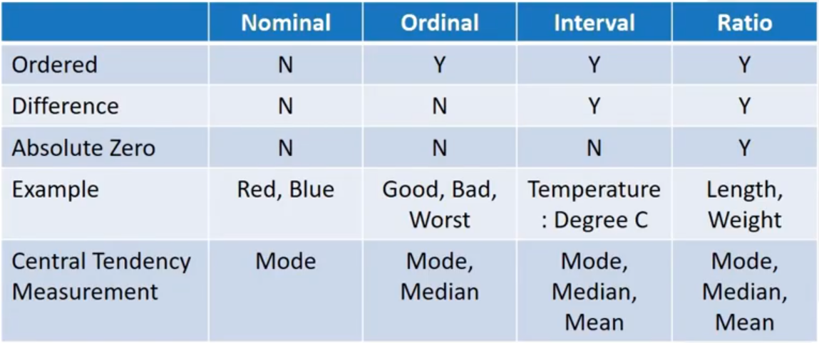
Scales of Measurement

Slide 27
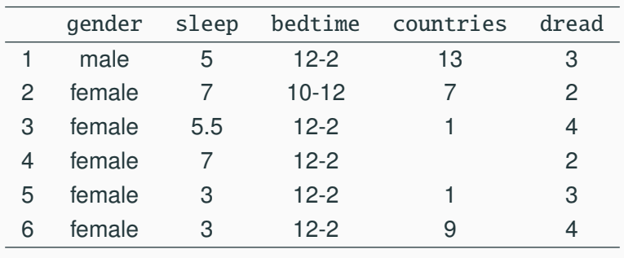
Scales of Measurement

Slide 28
Cross-sectional vs Longitudinal Data
Cross-sectional data are collected at the same or approximately the same point in time.
Example:
Data detailing the number of building permits issued in November 2013 in each of the counties of Ohio.
Longitudinal data, sometimes referred to as panel data, track the same sample at different points in time. The sample can consist of individuals, households, establishments, and so on.
Example:
Survey to understand employee satisfaction over two time periods.

Slide 29
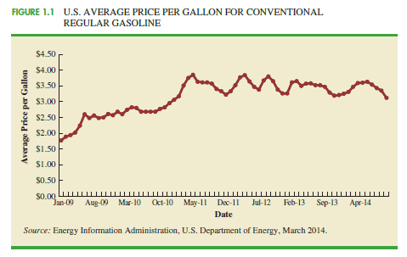
Time Series Data
Time series data are collected over several time periods.
Example
Data detailing the number of building permits issued in Lucas County, Ohio in each of the last 36 months.
Graphs of time series data help analysts understand
what happened in the past
identify any trends over time, and
project future levels for the time series

Slide 30
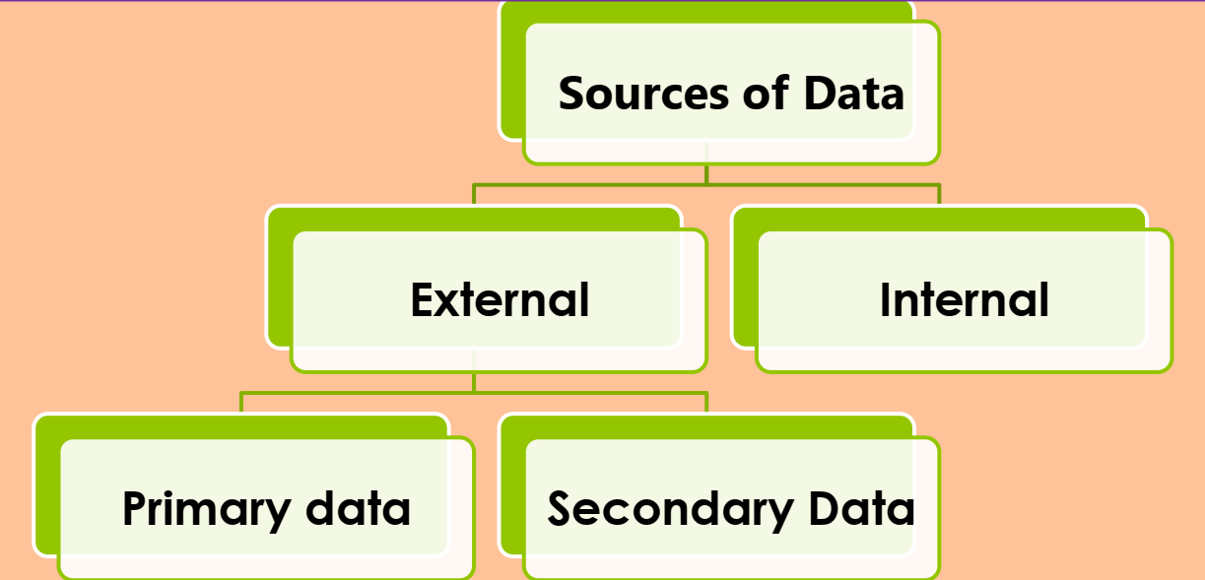
Data Sources
Data may be obtained from
Internal Sources
External Sources
Surveys and Experiments

Slide 31
Data Sources
Existing Sources
Internal company records – almost any department
Business database services – Dow Jones & Co.
Government agencies - U.S. Department of Labor
Industry associations – Travel Industry Association of America
Special-interest organizations – Graduate Management Admission Council (GMAT)
Internet – more and more firms

Slide 32
Data Sources
Data Available From Internal Company Records
Record | Some of the Data Available
Employee records | Name, address, social security number
Production records | Part number, quantity produced, direct labor cost, material cost
Inventory records | Part number, quantity in stock, reorder level, economic order quantity
Sales records | Product number, sales volume, sales volume by region
Credit records | Customer name, credit limit, accounts receivable balance
Customer profile | Age, gender, income, household size

Slide 33
Data Sources
Data Available From Selected Government Agencies
Government Agency | Web address | Some of the Data Available
Census Bureau | www.census.gov | Population data, number of households, household income
Federal Reserve Board | www.federalreserve.gov | Data on money supply, exchange rates, discount rates
Office of Mgmt. & Budget | www.whitehouse.gov/omb | Data on revenue, expenditures, debt of federal government
Department of Commerce | www.doc.gov | Data on business activity, value of shipments, profit by industry
Bureau of Labor Statistics | www.bls.gov | Customer spending, unemployment rate, hourly earnings, safety record

Slide 34
Type of Study
Statistical Studies – Observational
In observational (nonexperimental) studies no attempt is made to control or influence the variables of interest.
Example - Survey
Studies of smokers and nonsmokers are observational studies because researchers do not determine or control who will smoke and who will not smoke.

Slide 35
Type of Study
Statistical Studies – Experimental
In experimental studies the variable of interest is first identified. Then one or more other variables are identified and controlled so that data can be obtained about how they influence the variable of interest.
E.g. suppose a pharmaceutical company would like to learn about how a new drug it has developed affects blood pressure.

Slide 36
Data Acquisition Considerations
Time Requirement
Searching for information can be time consuming.
Information may no longer be useful by the time it is available.
Cost of Acquisition
Organizations often charge for information even when it is not their primary business activity.
Data Errors
Using any data that happen to be available or were acquired with little care can lead to misleading information.

Slide 37
Analytics
Analytics is the scientific process of transforming data into insight for making better decisions.
Techniques:
Descriptive analytics: This describes what has happened in the past.
Predictive analytics: Use models constructed from past data to predict the future or to assess the impact of one variable on another.
Prescriptive analytics: The set of analytical techniques that yield a best course of action.

Slide 38
Big data and Data Mining:
Big data: Large and complex data set.
Three V’s of Big data:
Volume : Amount of available data
Velocity: Speed at which data is collected and processed
Variety: Different data types

Slide 39
Data Warehousing
Data warehousing is the process of capturing, storing, and maintaining the data.
Organizations obtain large amounts of data on a daily basis by means of magnetic card readers, bar code scanners, point of sale terminals, and touch screen monitors.
Wal-Mart captures data on 20-30 million transactions per day.
Visa processes 6,800 payment transactions per second.

Slide 40
Data Mining
Methods for developing useful decision-making information from large databases.
Using a combination of procedures from statistics, mathematics, and computer science, analysts “mine the data” to convert it into useful information.
The most effective data mining systems use automated procedures to discover relationships in the data and predict future outcomes prompted by general and even vague queries by the user.

Slide 41
Data Mining Applications
The major applications of data mining have been made by companies with a strong consumer focus such as retail, financial, and communication firms.
Data mining is used to identify related products that customers who have already purchased a specific product are also likely to purchase (and then pop-ups are used to draw attention to those related products).
Data mining is also used to identify customers who should receive special discount offers based on their past purchasing volumes.

Slide 42
Data Mining Requirements
Statistical methodology such as multiple regression, logistic regression, and correlation are heavily used.
Also needed are computer science technologies involving artificial intelligence and machine learning.
A significant investment in time and money is required as well.

Slide 43
Ethical Guidelines for Statistical Practice
In a statistical study, unethical behavior can take a variety of forms including:
Improper sampling
Inappropriate analysis of the data
Development of misleading graphs
Use of inappropriate summary statistics
Biased interpretation of the statistical results
One should strive to be fair, thorough, objective, and neutral as you collect, analyze, and present data.
As a consumer of statistics, one should also be aware of the possibility of unethical behavior by others.

Slide 44
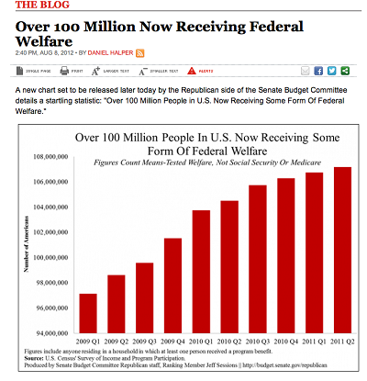
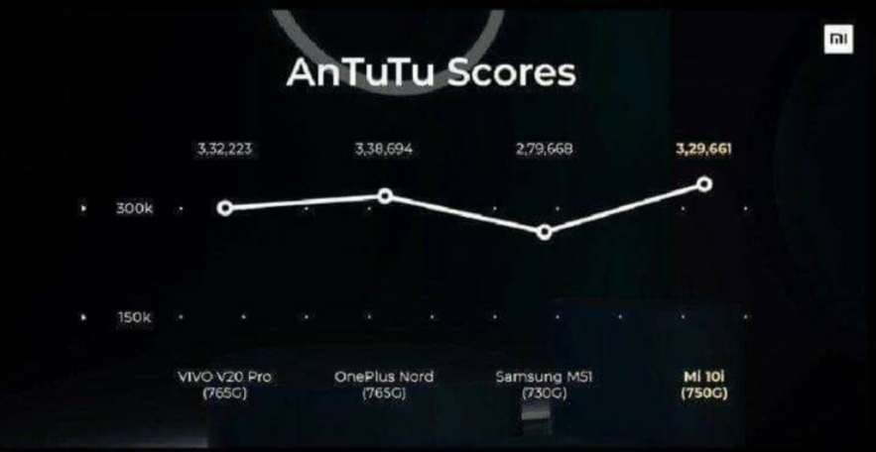
Ethical Guidelines for Statistical Practice

Slide 45
End of Chapter 1

